Slide 1
Neural Signal Compression for Brain-Machine Interfaces
Neuralink, US 2023/0284982 A1, Filed 3/9/2022, Published 9/14/2023
6/9/2024

Slide 2
Background
Technique for transmitting and processing neural data
Gathering/transmitting data as-a-whole wirelessly leads to excessive amount of information, increased latency/delay of signal transmission
Data compression - reduces size and space, improves system performance
Compression standards:
Image: jpg, jpeg
Audio: mp3
Video: mpeg2
Utilities: gzip, bzip2

Slide 3
Outline
Goal: Introduce techniques for neural signal compression to prevent data overflow and latency issues, reduce size/space, backing up, improve system performance.
Compression Techniques:
Lossless compression
Lossy compression
Sparse compression:
Binned-spikes
Spike-band

Slide 4
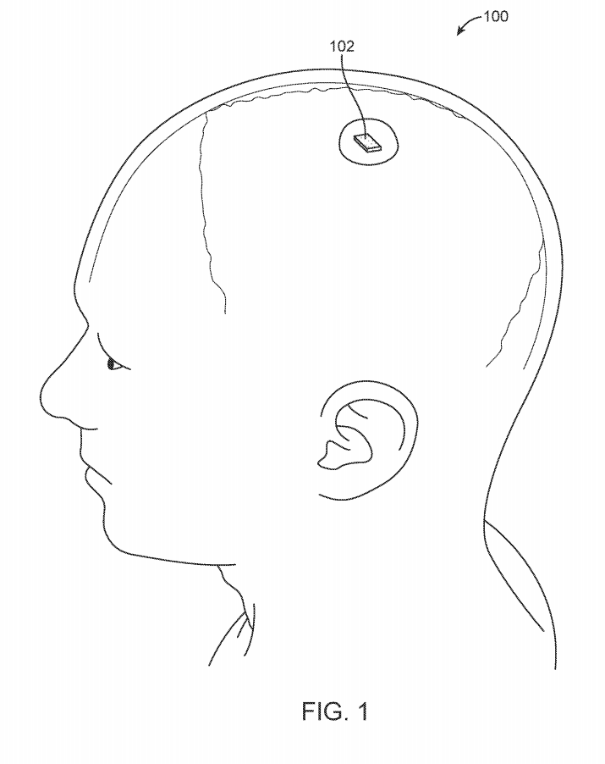
Overall Usage Diagram
neurotransmitter

Slide 5
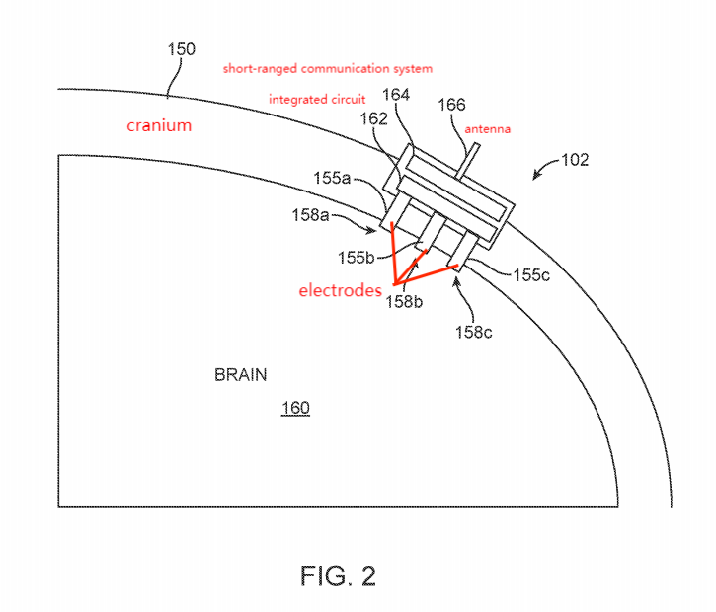
Sectional Side View of Neurotransmitter

Slide 6
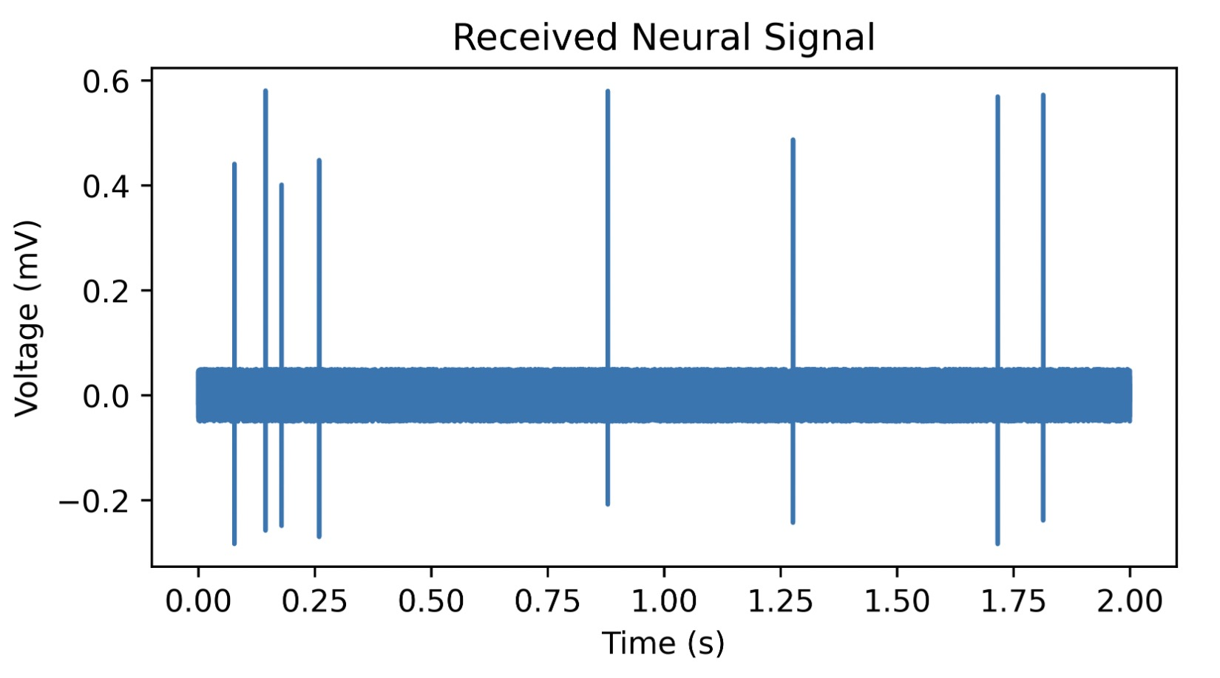
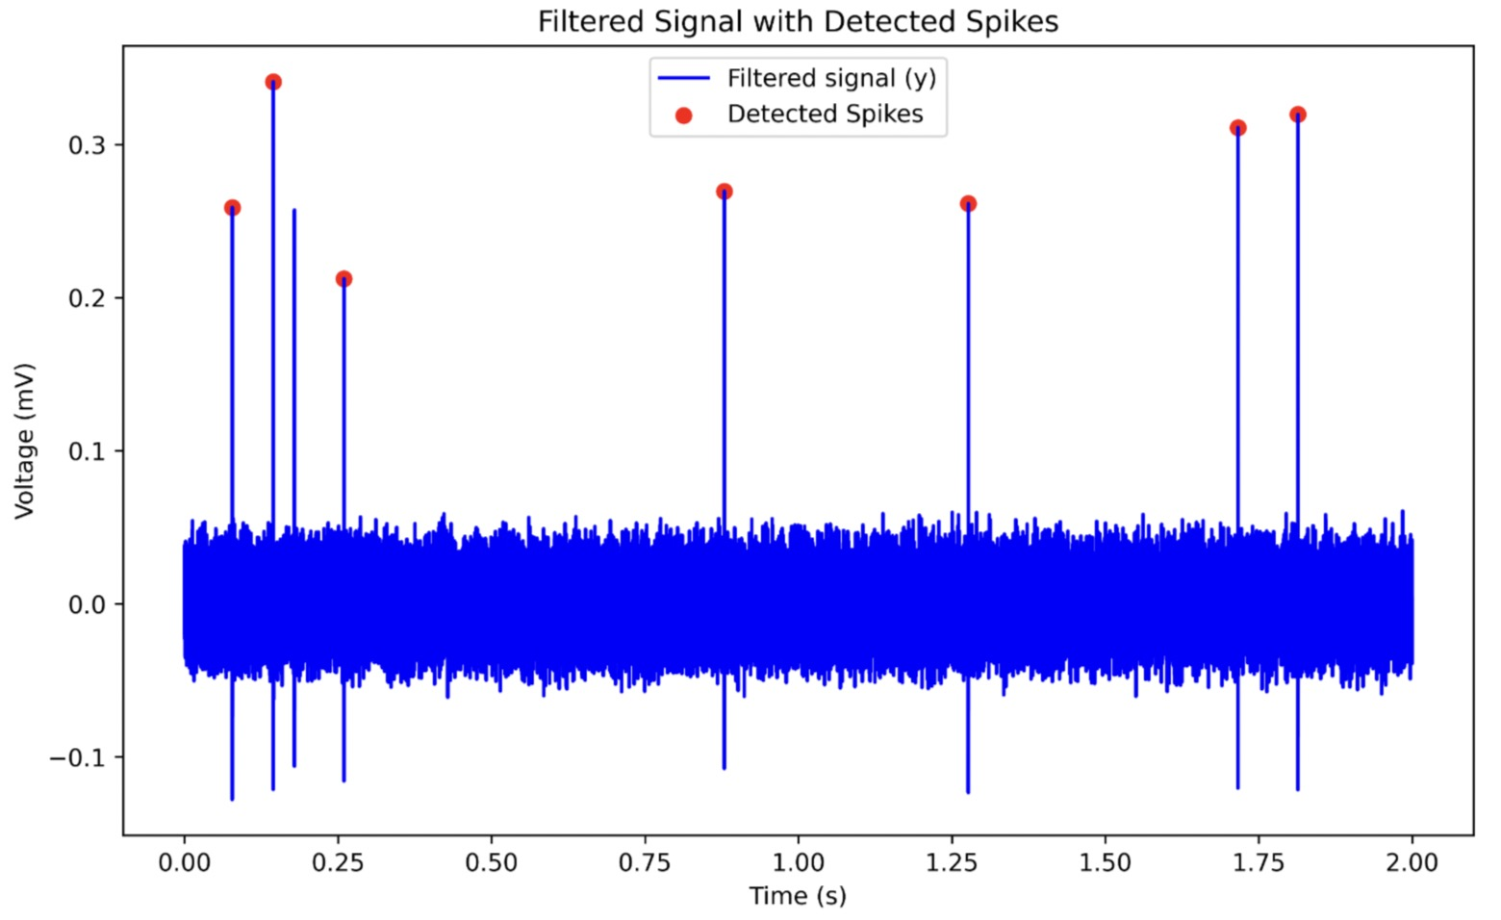
Review: Spike Detection
Procedure:
Receive Signal
Filter signal
Fit filtered signal to model (Smoothing)
Identify fit values (local minima & maxima)
Compute characteristic values
Compare characteristic values to threshold values
Determine whether spike is detected
Transmit indication of neural spikes

Slide 7
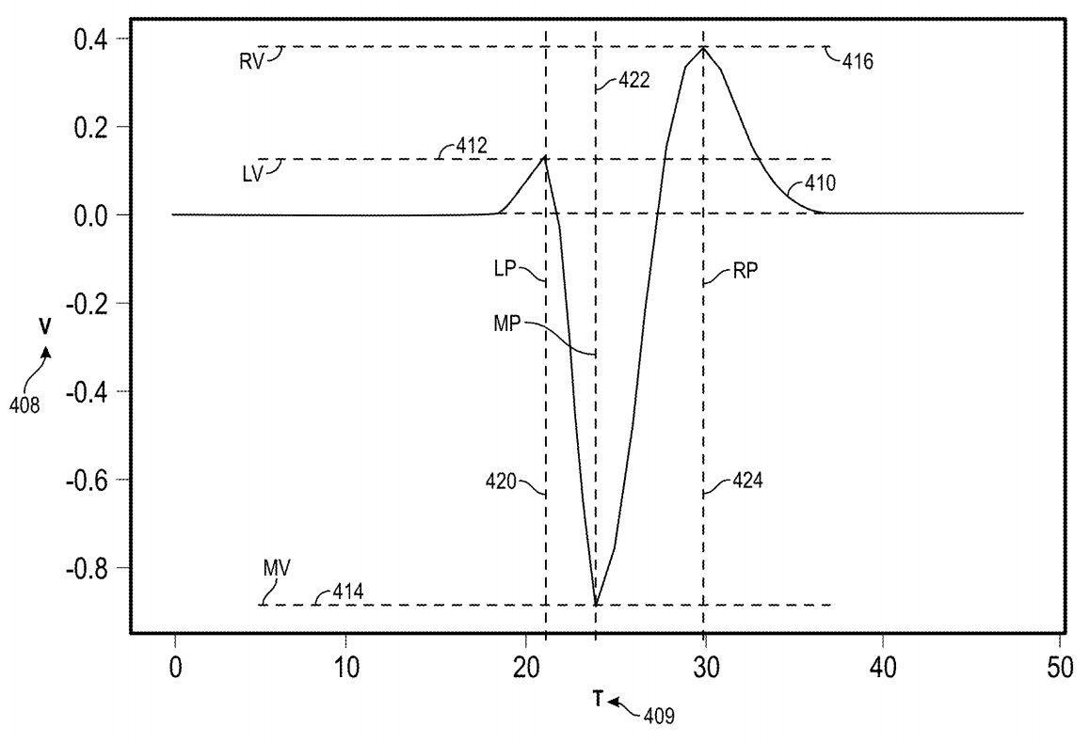
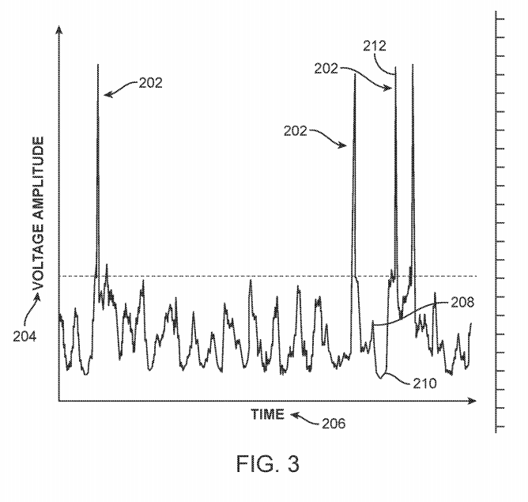
Review: Spike Detection
Refer to US patent application number 2021/0012909 A1, “Real-Time Neural Spike Detection” and this notebook for more details

Slide 8
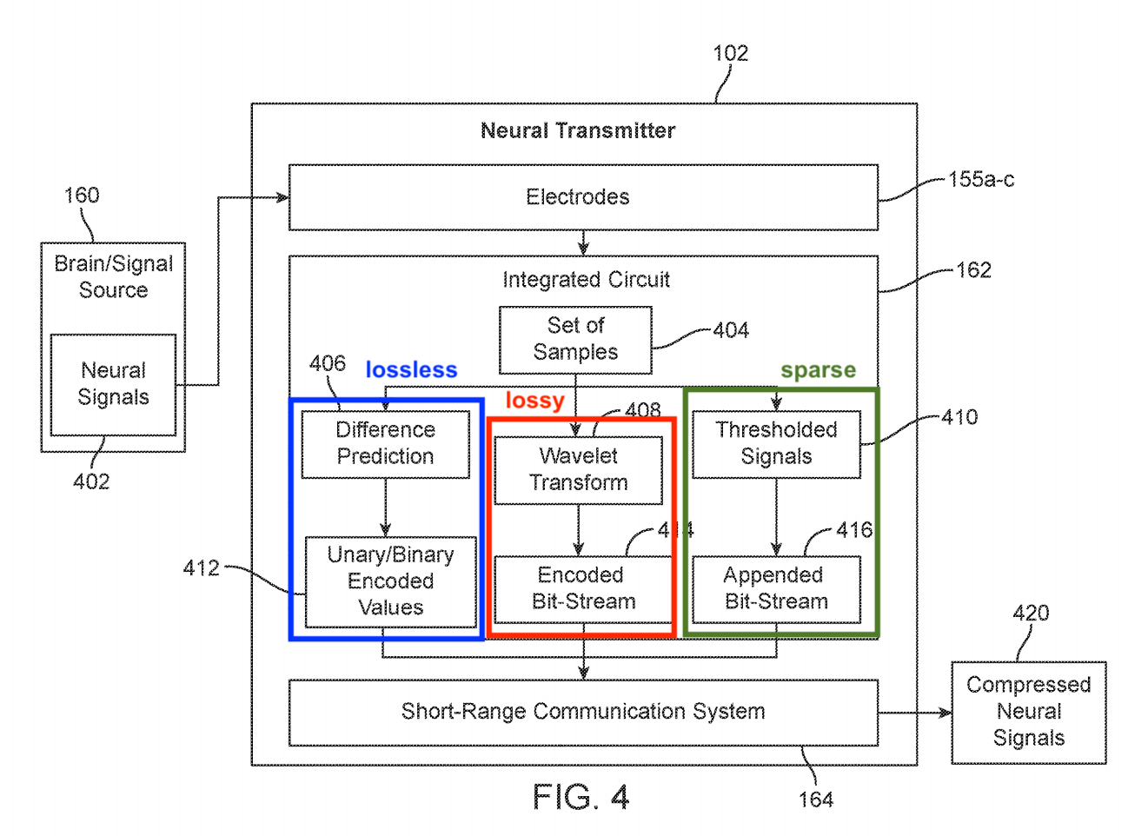
Neural Transmitter - Signal Flowchart

Slide 9
About the Compression Algorithms
4 Operating Modes of Compression
Lossless
Lossy
Sparse: Binned-Spikes
Sparse: Spike-Band
Neural transmitter may alternate between modes as appropriate, depending on the dataset

Slide 10
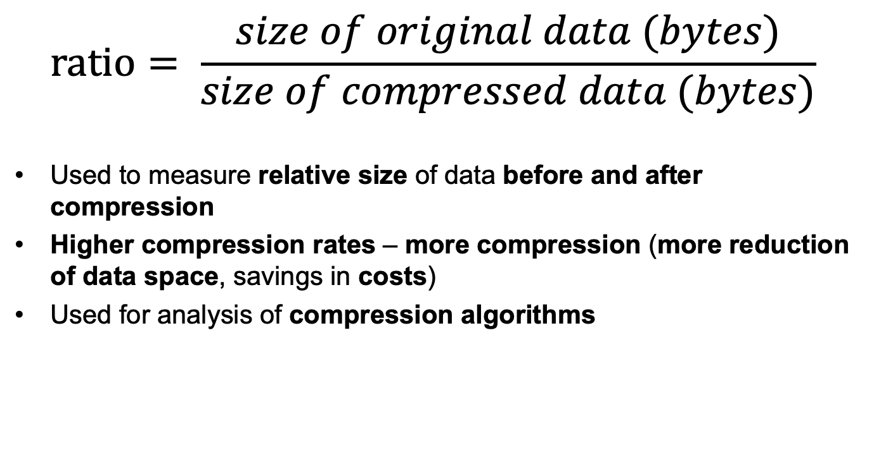
Compression Ratio
$$ratio= \frac{size of original data (bytes)}{size of compressed data (bytes)}$$
Used to measure relative size of data before and after compression
Higher compression rates – more compression (more reduction of data space, savings in costs)
Used for analysis of compression algorithms

Slide 11
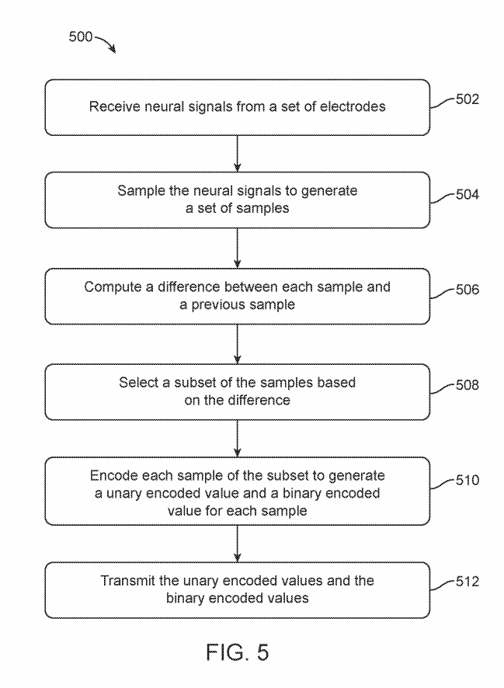
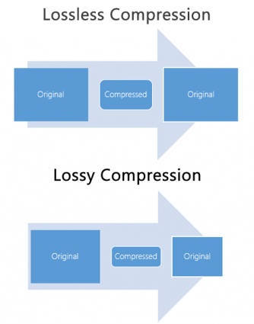
Lossless compression
Retains original data shape & quality
Difference prediction
Binary + unary encoding
e.g., wav, ape

Slide 12
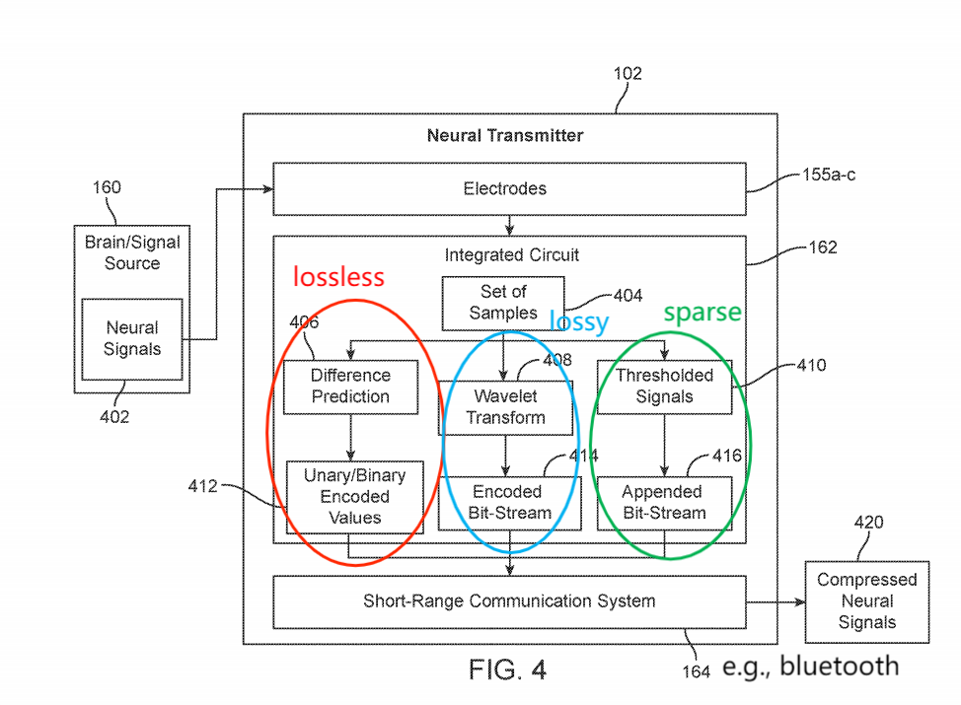
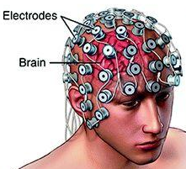
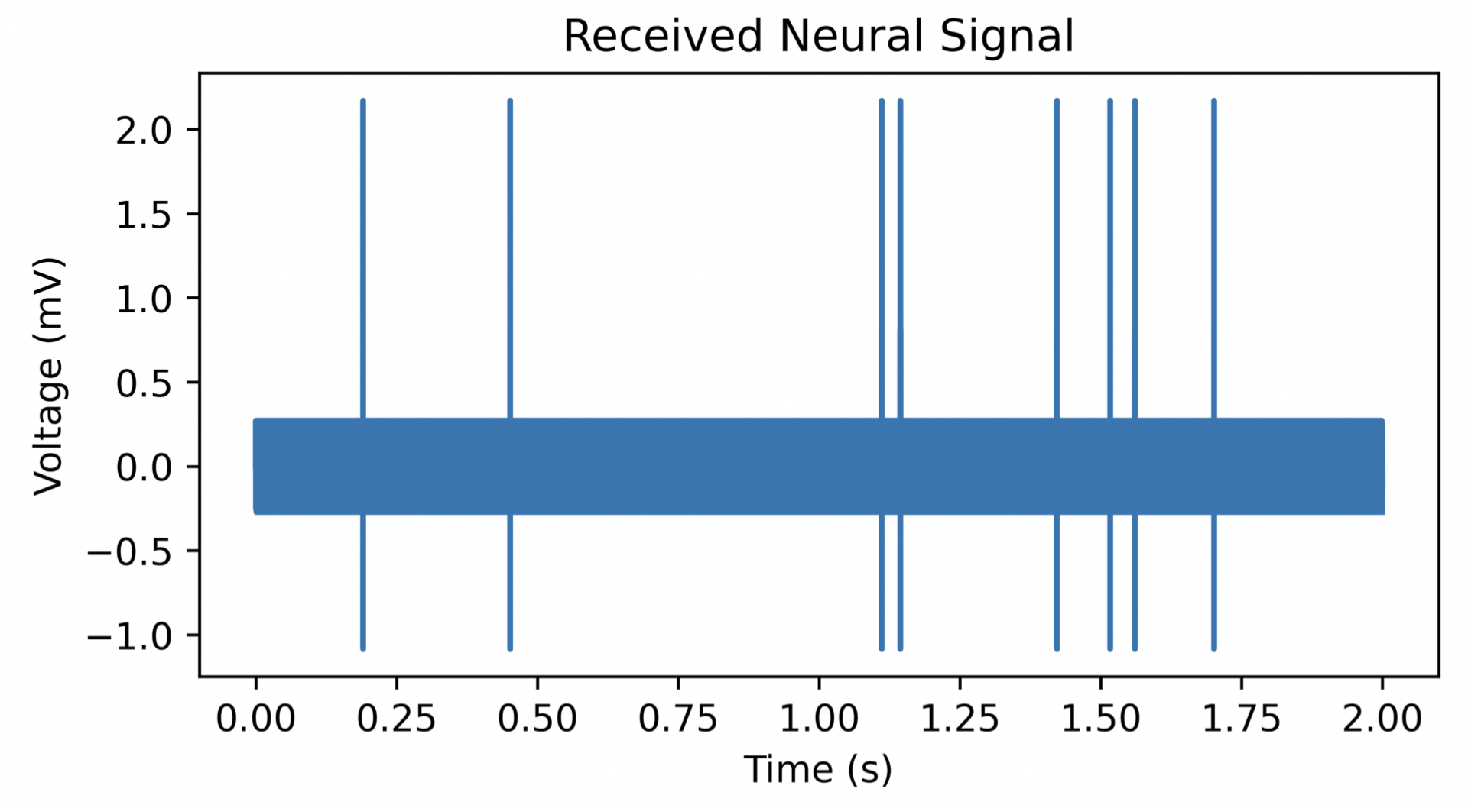
Step 1:

Slide 13
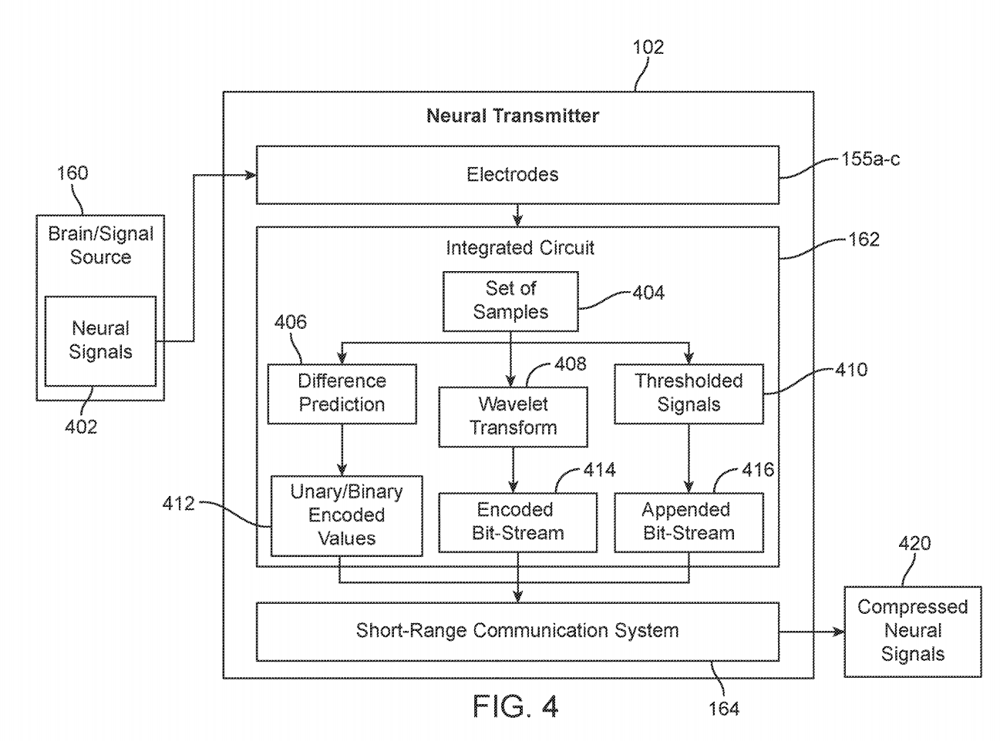
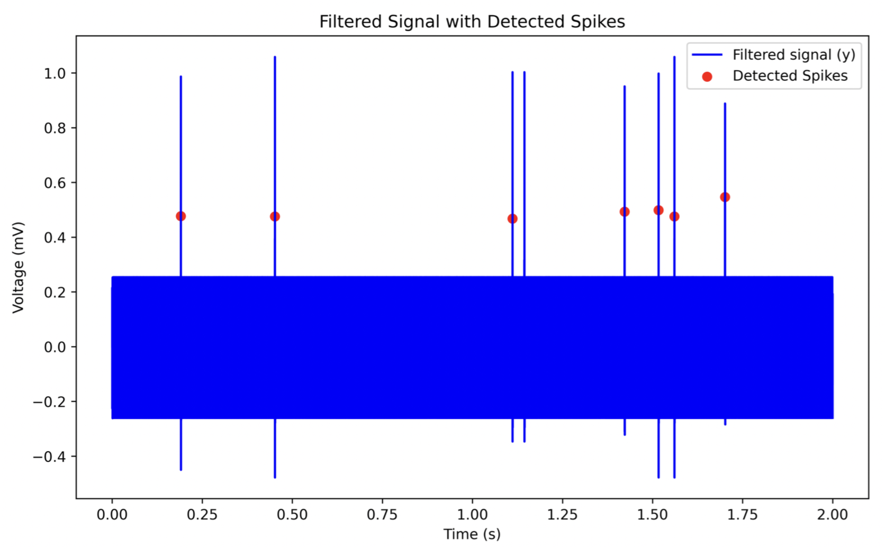
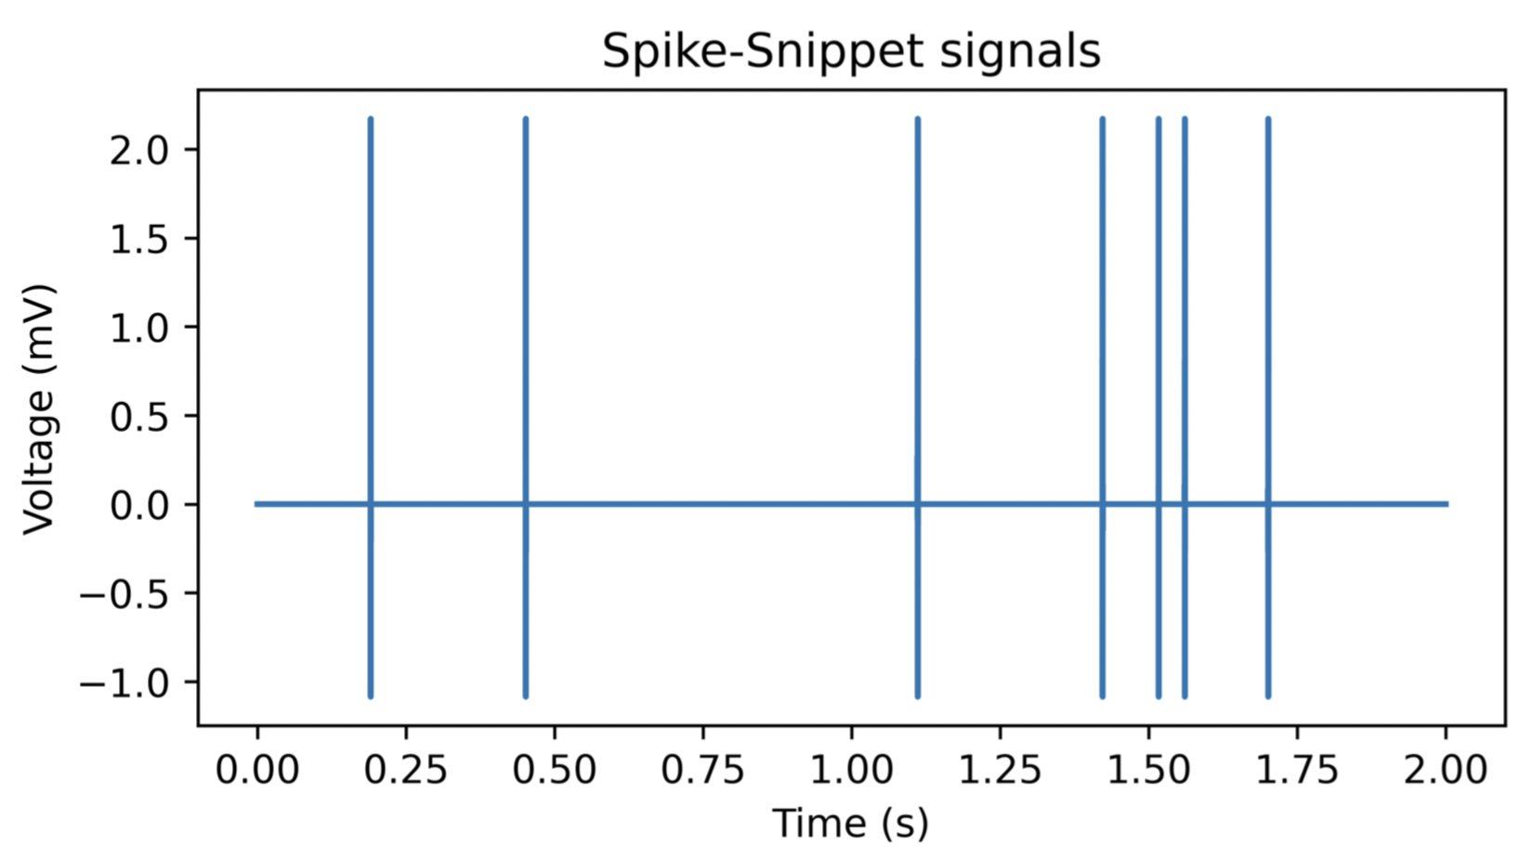
Step 2:
Detect Neural Spikes
Use spike-snippets mode: Only take signals that revolve around spikes

Slide 14
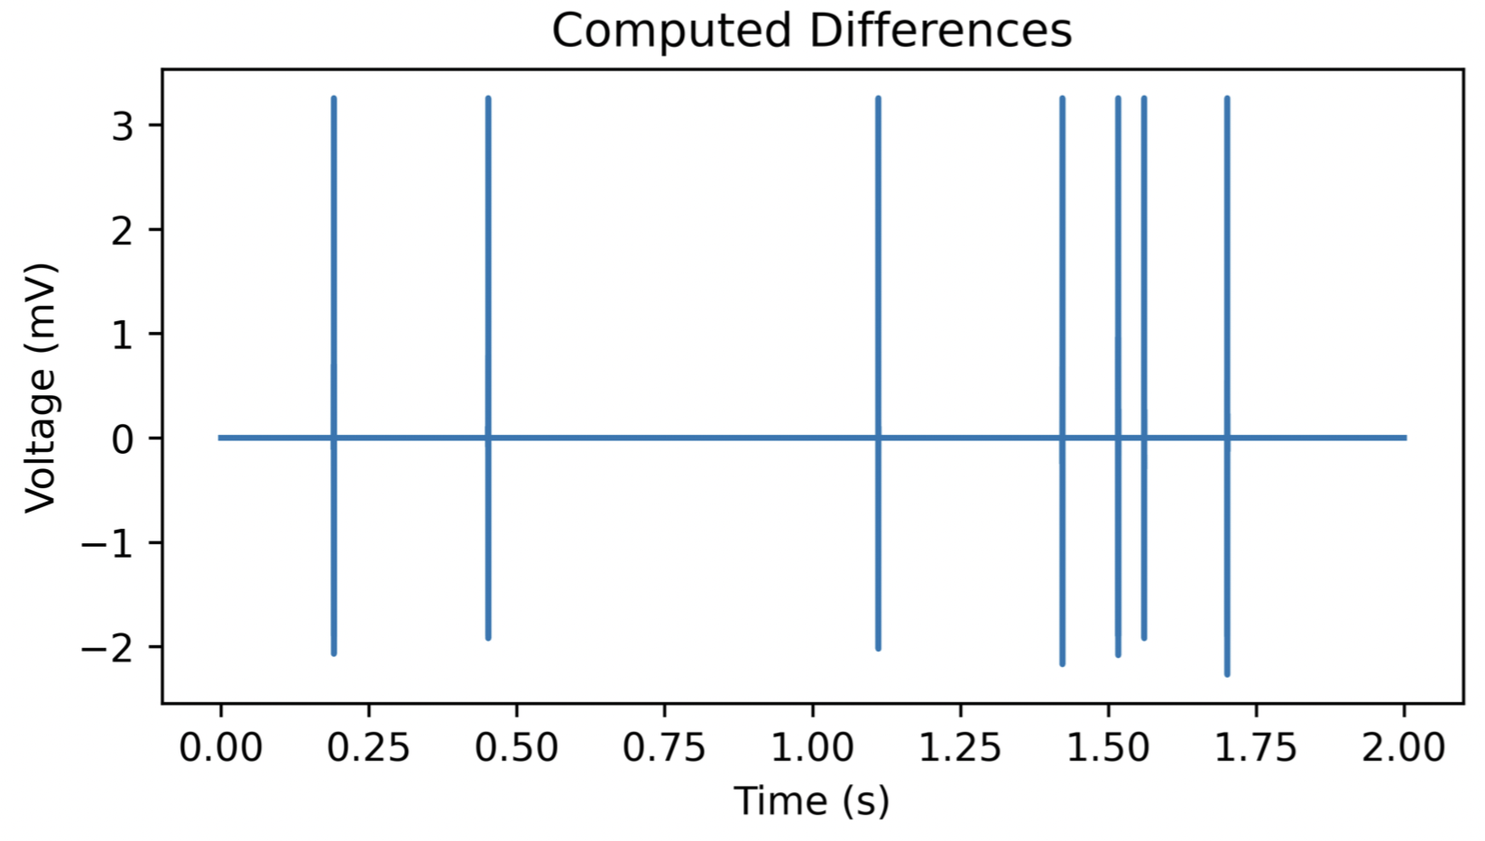
Step 3:
The differences can be represented as:
y[n] = x[n] – x[n - 1]

Slide 15
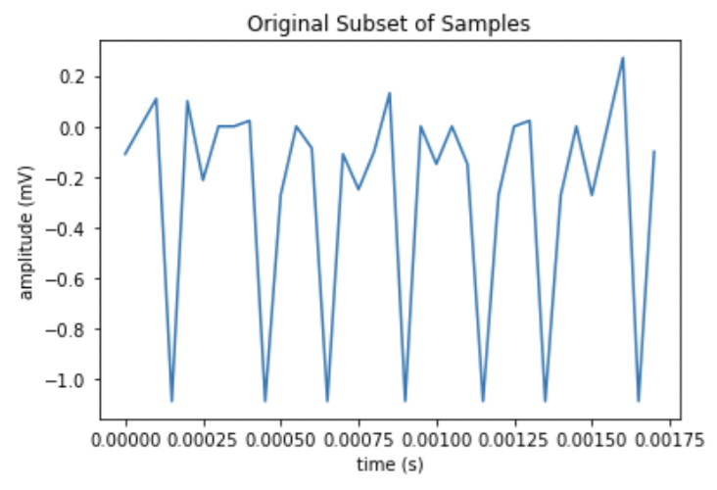
Step 4:
- Remove values with zero or close to 0 difference (y[n]=x[n]-x[n-1]=0)
- Reduce duplicative data by identifying samples with different values
- Particularly useful - most signals received are duplicates

Slide 16
Step 5:
Compute a factor that minimizes total size of each encoded sample
Need high-compression ratio with low computational cost (minimal space and power usage)
Use Rice-Golomb encoding technique
Achieves high compression ratio
Low complexity - minimal power and space usage

Slide 17
Unary encoding
Given a positive integer n, the unary encoding of n is given by q(n) = (n or n-1) “1”s followed by 1 “0”
The “0”s and “1”s are interchangeable
Optimally efficient (prefix-free, unique)
n | Unary code
1 | 10
2 | 110
3 | 1110
4 | 11110
5 | 111110
Source: https://en-academic.com/dic.nsf/enwiki/148876

Slide 18
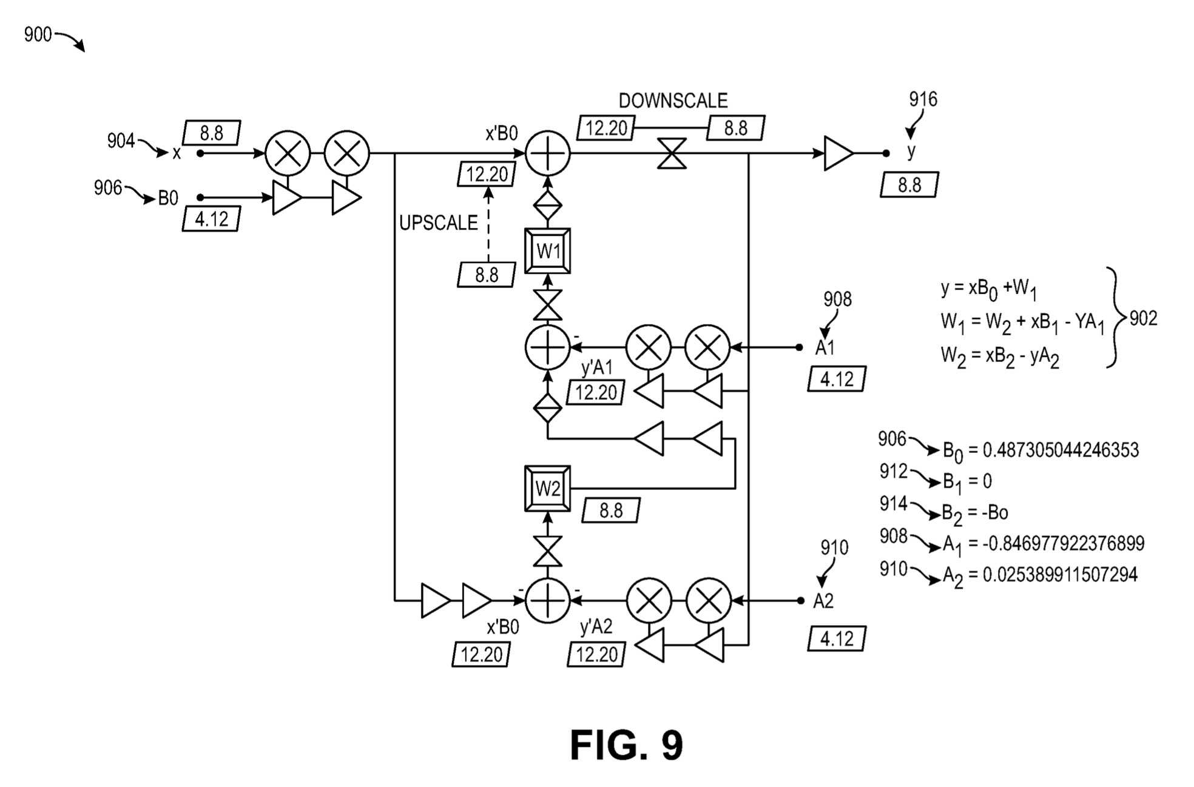
From “Real-Time Neural Spike Detection” patent
X: Q8.8 encoding (8 bits integer, 8 bits fraction)

Slide 19
Decimal to Q8.8 Binary Encoding
8 bits decimal (d), 8 bits fraction (f)
e.g., 12.375 = 00001100.01100000
→ 0000110001100000 (* 2^f)

Slide 20
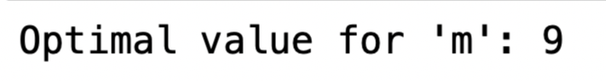
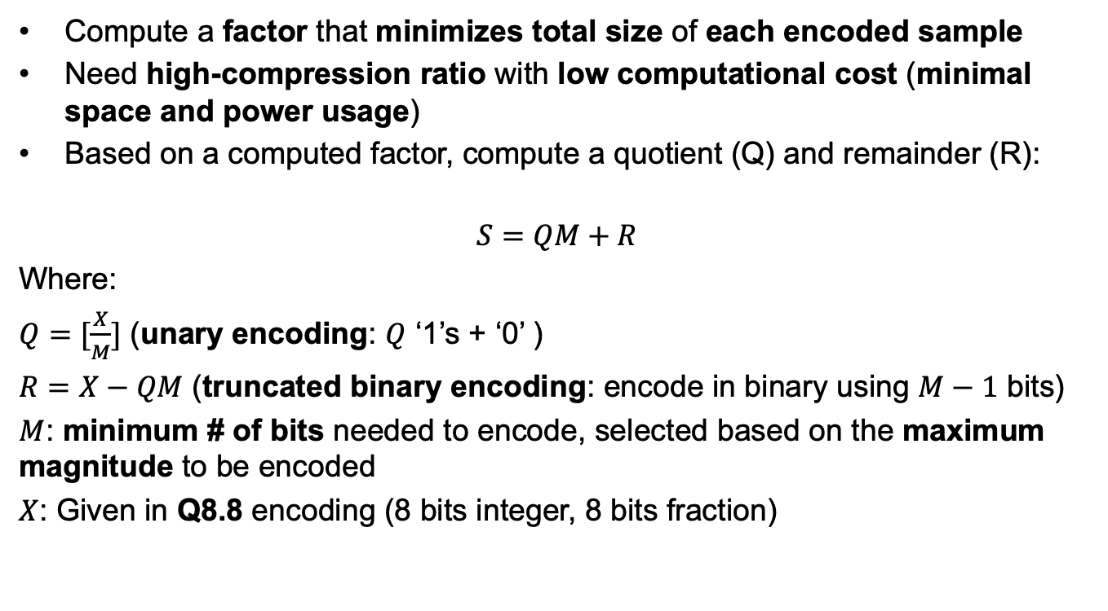
Rice-Golomb Encoding
Compute a factor that minimizes total size of each encoded sample
Need high-compression ratio with low computational cost (minimal space and power usage)
Based on a computed factor, compute a quotient (Q) and remainder (R):
$$S=QM+R$$
Where:
$Q=[\frac{X}{M}]$ (unary encoding: $Q$ ‘1’s + ‘0’ )
$R=X−QM$ (truncated binary encoding: encode in binary using $M−1$ bits)
$M$: minimum # of bits needed to encode, selected based on the maximum magnitude to be encoded
$X$: Given in Q8.8 encoding (8 bits integer, 8 bits fraction)
For Q8.8 encoding, need m = 8 + 1 = 9 bits for encoding

Slide 21
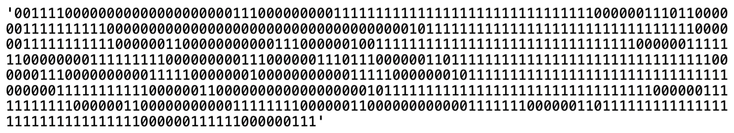
Step 6:
Transmit to external computing device, which decodes signal (reverse process above)
Can transmit via bluetooth
Bitstream: ‘00’ (lossless) + Encoded values (unary + binary)

Slide 22
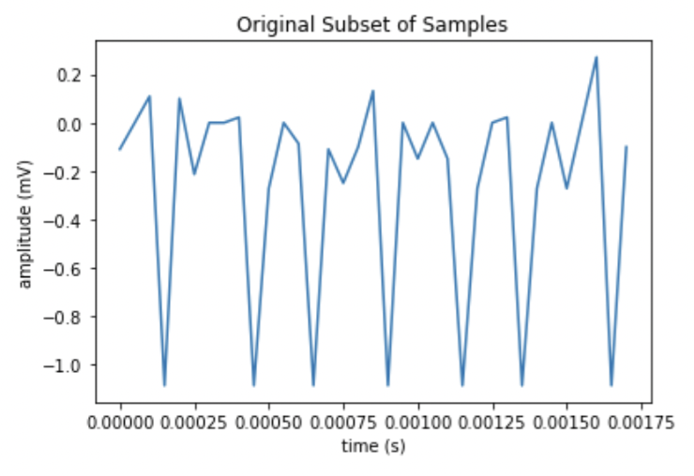
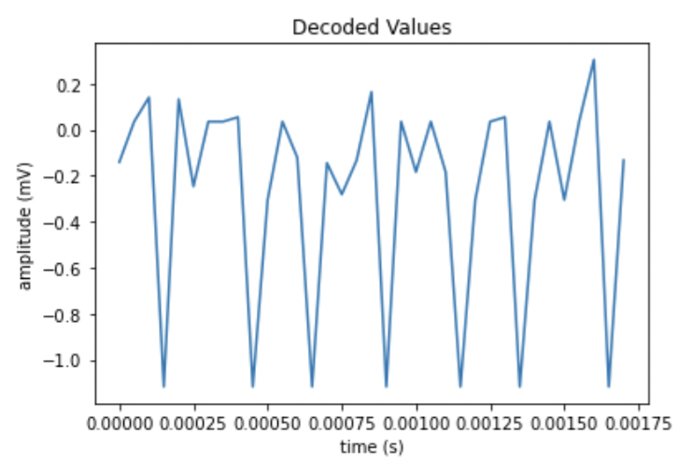
Signal Reconstruction
Original (from step 4; left) vs decoded signals (right)

Slide 23
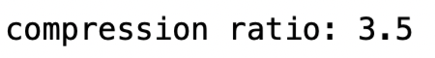
Lossless: Compression Ratio
Expected compression ratio: approximately 3:1

Slide 24
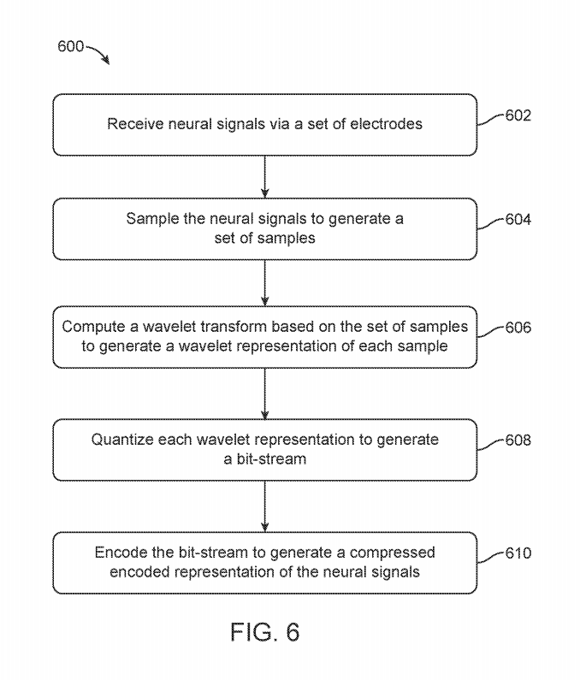
Lossy compression
May lose some original data (as long as it does not affect the user)
Quantized wavelet transforms
e.g. mp3, jpeg

Slide 25
Step 1:

Slide 26
Step 2:
Detect Neural Spikes
Use spike-snippets mode: Only take signals that revolve around spikes

Slide 27
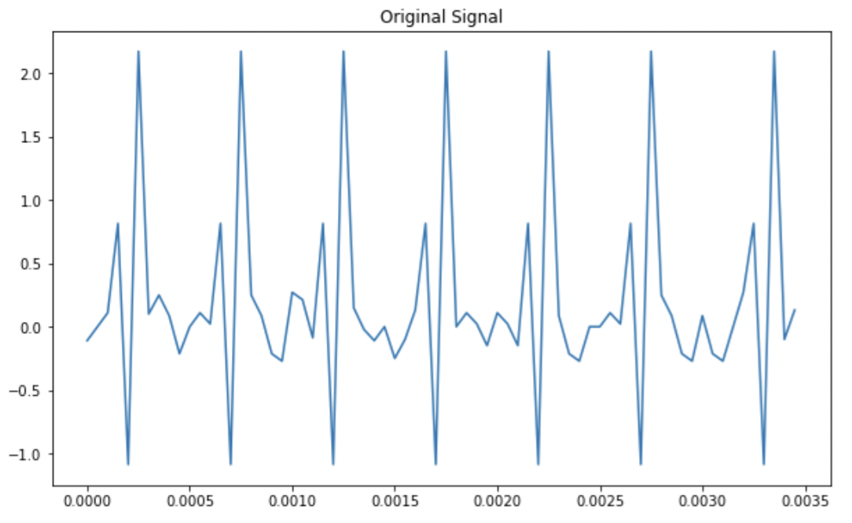
Step 2:
3. Out of the spike-snippets, ONLY pick the signals revolving around spikes
Look like wavelets, eh?

Slide 28
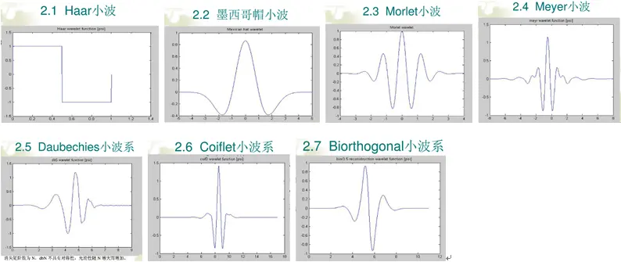
Step 3:
Decompose original spike-snippets signal into individual wavelet components (approximation & detail coefficients)
Can use Biorthogonal 2.2 (Bior 2.2), Haar transform, sliding discrete Fourier transform (sliding DFT), Goertzel algorithm, sliding Goertzel algorithm.

Slide 29
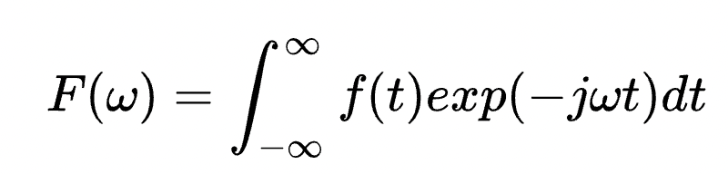
Fast Fourier Transforms: Limitations
Fast Fourier Transforms (FFTs) are expressed by:
Cannot capture non-stationary signals effectively (every position is treated equally)
After integration – frequency domain does not contain time information
Filtering - FFT ineffective when signal and noise are mixed together – FFT relies on signal & noise separation
Short-term FFT – fixed window length
What if…we want a variable window length?

Slide 30
Discrete Wavelet Transform (DWT)
Wavelet transforms: Rapidly decaying wave signals with limited energy (signal is nonzero over a finite interval), concentrated in local areas
“Discrete” data – computationally efficient
Can capture short-term, non-stationary impulses (e.g., spikes) in the signal
Good for “lossy” compression:
Localization of time & frequency domain - can effectively capture localized regions like spikes
Energy compaction – most energy concentrated in low-frequency (approximation) components for data reduction while preserving important information
Multi-resolution analysis – capture both high and low-frequency components
Sparse representation – most coefficients close to 0, which can be discarded with minimal information loss
Scalability – can adjust level of decomposition and coefficient thresholds to control balance between compression ratio and signal quality

Slide 31
Discrete Wavelet Transform (DWT)
Most common wavelets:

Slide 32
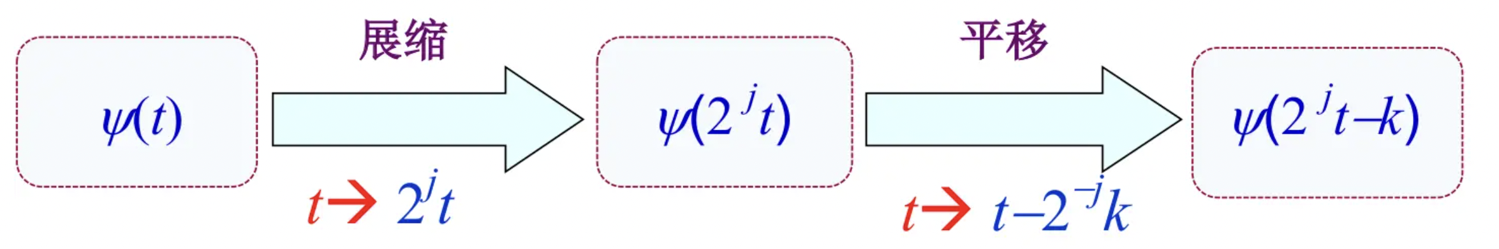
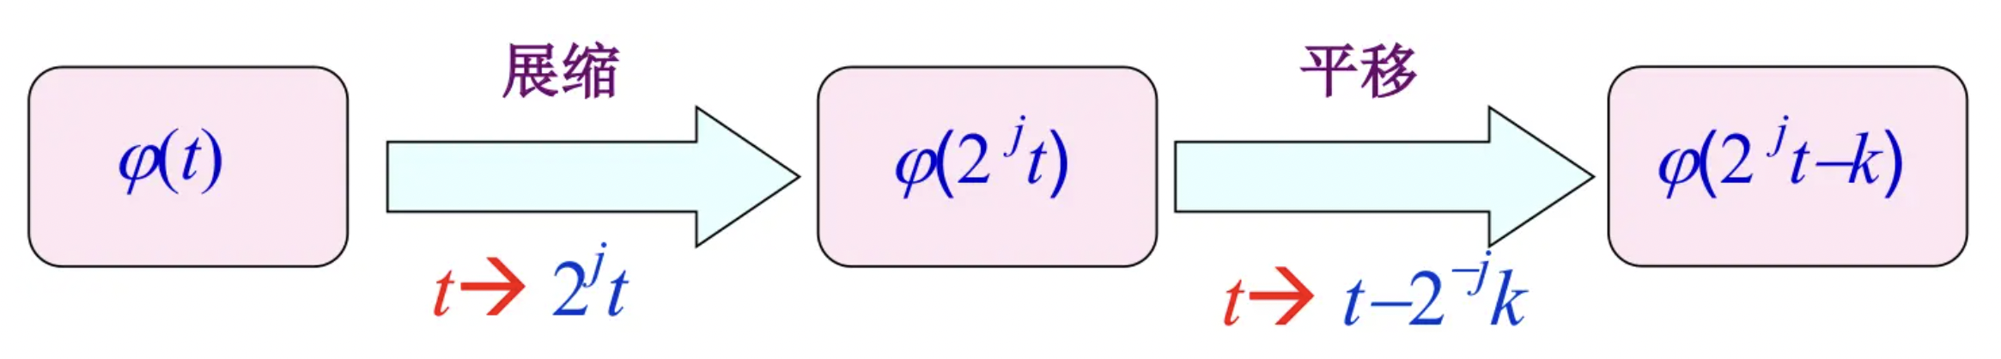
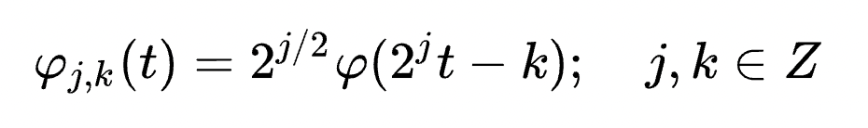
Discrete Wavelet Transform (DWT)
Wavelet function ($ψ$): Obtained from high-frequency components
Expansion/Contraction
Translation
Scaling function ($φ$): Obtained from low-frequency components
2-scale relation (dilation equation): Maintain energy of the basis function (always at 1)

Slide 33
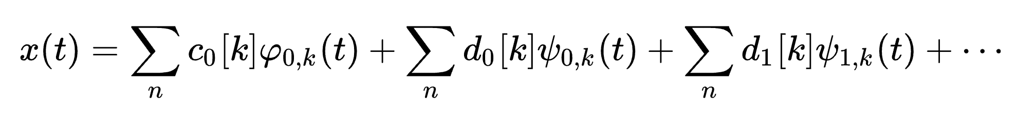
Discrete Wavelet Transform (DWT)
We can define the overall signal x(t) as:
Approximation coefficients
Scaling functions
Detail coefficients
Wavelet functions

Slide 34
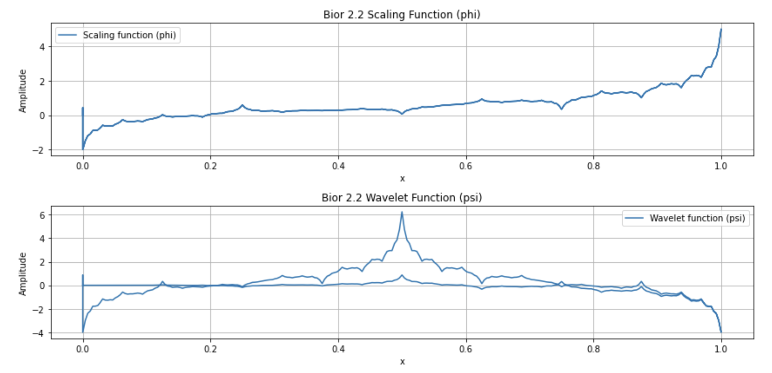
Biorthogonal 2.2 (Bior 2.2) Wavelet
Symmetric - useful for preserving phase & structure of original signal
Biorthogonal: 2 sets of wavelets:
Decomposition (analysis)
Reconstruction (synthesis)
Bior 2.2 – order 2 wavelet function + order 2 scaling function (2 vanishing moments/coefficients each)
Compact support: signal is nonzero over finite interval (computationally efficient)

Slide 35
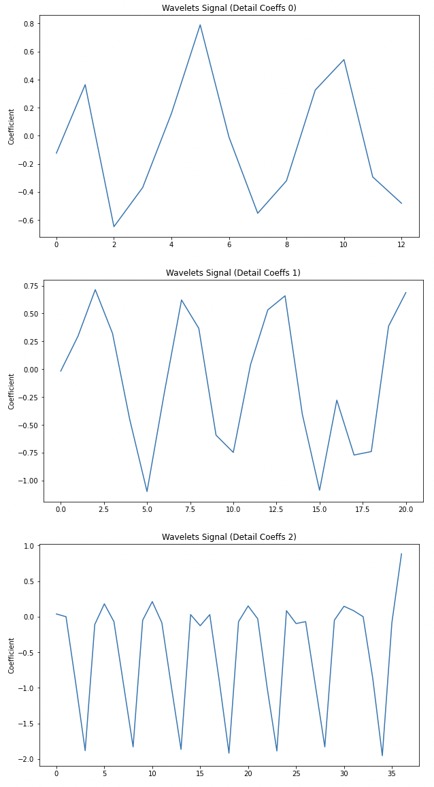
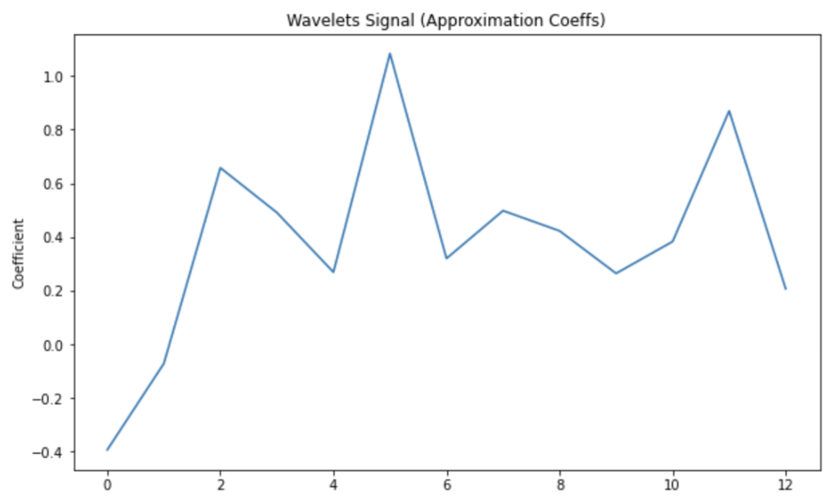


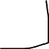
Approximation + Detail Coefficient Plots
+

Slide 36
Step 4:
Restrict each wavelet representation into discrete values (unary/binary) via PMF quantization
Reduce amount of bits/resources per detail
Most information stored in low frequencies (approximation coefficients)
1. Estimate PMF based on approximation coefficients
2. Define quantization levels based on PMF
3. Apply quantization on approximation coefficints

Slide 37
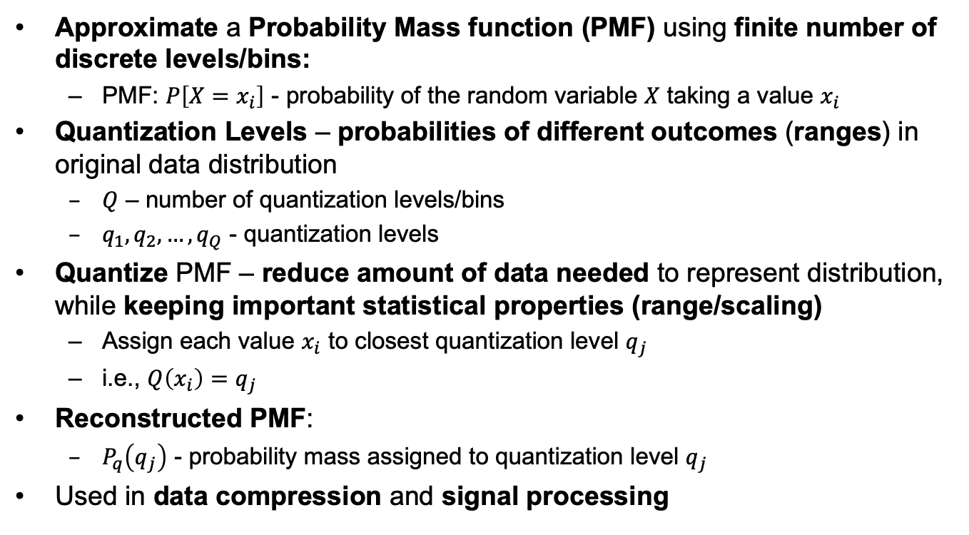
PMF Quantization
Approximate a Probability Mass function (PMF) using finite number of discrete levels/bins:
PMF: $P\left[X=x_{i}\right]$ - probability of the random variable $X$ taking a value $x_{i}$
Quantization Levels – probabilities of different outcomes (ranges) in original data distribution
$Q$ – number of quantization levels/bins
$q_{1},q_{2}, …,q_{Q}$ - quantization levels
Quantize PMF – reduce amount of data needed to represent distribution, while keeping important statistical properties (range/scaling)
Assign each value $x_{i}$ to closest quantization level $q_{j}$
i.e., $Q\left(x_{i}\right)=$ $q_{j}$
Reconstructed PMF:
$P_{q}\left(q_{j}\right)$ - probability mass assigned to quantization level $q_{j}$
Used in data compression and signal processing

Slide 38
Step 5:
Use fast range asymmetric numerical systems (fast-rANS) for encoding – relies on accurate distribution of spike counts per bin
Relax some constraints in PMF quantization (allow PMF approximation, adjust quantized probabilities on the fly) --> causes loss of marginal data (“lossy”)
Tracking spike categories – increases compression ratio

Slide 39
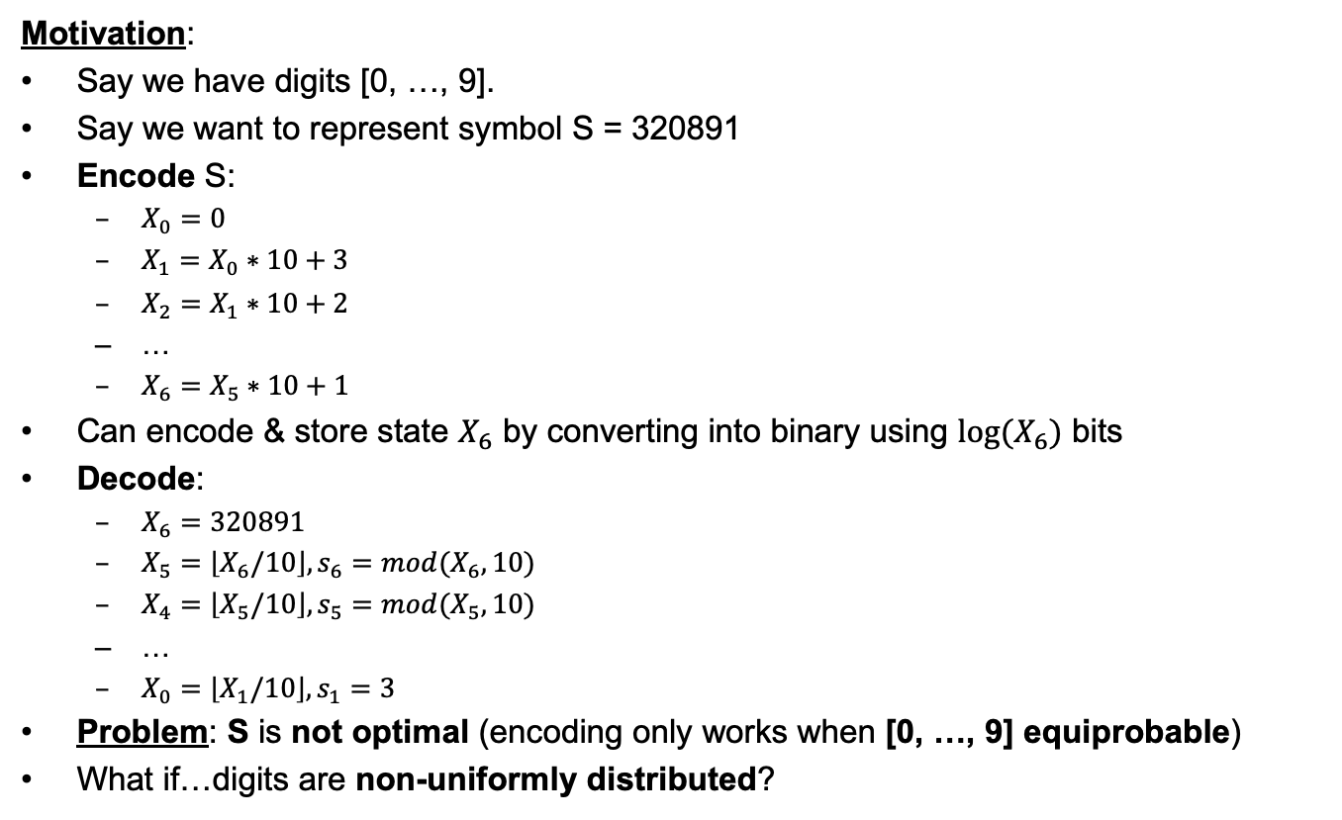
Range Asymmetric Numerical Systems (rANS) Encoding
Motivation:
Say we have digits [0, …, 9].
Say we want to represent symbol S = 320891
Encode S:
$X_{0}=0$
$X_{1}=$ $X_{0}∗10+3$
$X_{2}=$ $X_{1}∗10+2$
…
$X_{6}=$ $X_{5}∗10+1$
Can encode & store state $X_{6}$ by converting into binary using $log(X_{6})$ bits
Decode:
$X_{6}=$ $320891$
$X_{5}=\left\lfloor X_{6}/10\right\rfloor , s_{6}=mod(X_{6},10)$
$X_{4}=\left\lfloor X_{5}/10\right\rfloor , s_{5}=mod(X_{5},10)$
…
$X_{0}=\left\lfloor X_{1}/10\right\rfloor , s_{1}=3$
Problem: S is not optimal (encoding only works when [0, …, 9] equiprobable)
What if…digits are non-uniformly distributed?

Slide 40
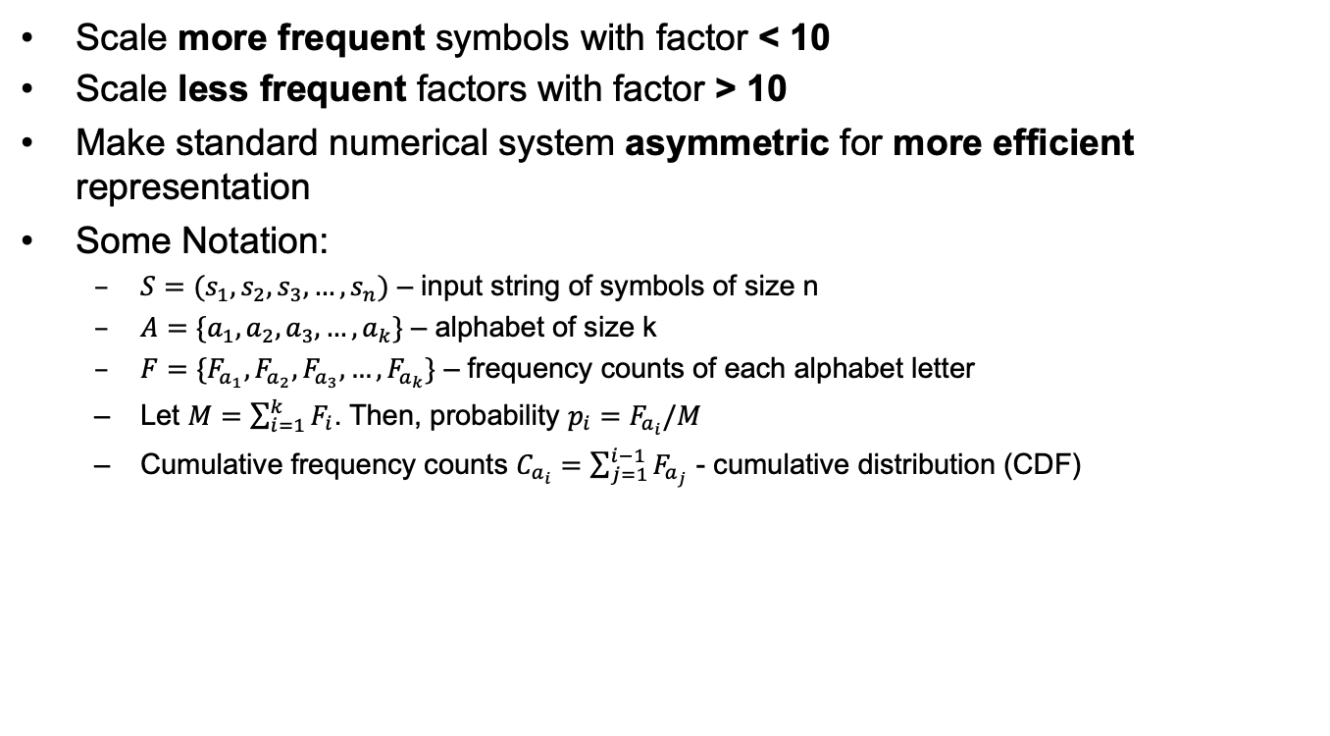
Range Asymmetric Numerical Systems (rANS) Encoding
Scale more frequent symbols with factor < 10
Scale less frequent factors with factor > 10
Make standard numerical system asymmetric for more efficient representation
Some Notation:
$S=(s_{1},s_{2},s_{3},…,s_{n})$ – input string of symbols of size n
$A=\{a_{1},a_{2},a_{3},…,a_{k}\}$ – alphabet of size k
$F=\{F_{a_{1}},F_{a_{2}},F_{a_{3}},…,F_{a_{k}}\}$ – frequency counts of each alphabet letter
Let $M=\sum_{i=1}^{k}{F_{i}}$. Then, probability $p_{i}=$ $F_{a_{i}}/M$
Cumulative frequency counts $C_{a_{i}}=\sum_{j=1}^{i−1}{F_{a_{j}}}$ - cumulative distribution (CDF)

Slide 41
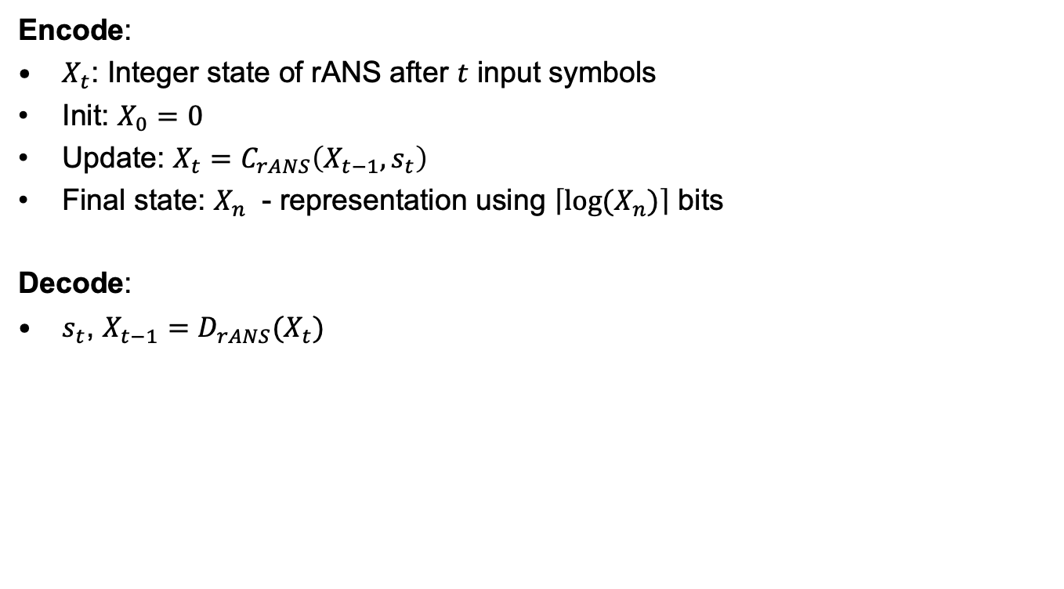
Range Asymmetric Numerical Systems (rANS) Encoding
Encode:
$X_{t}$: Integer state of rANS after $t$ input symbols
Init: $X_{0}=0$
Update: $X_{t}=$ $C_{rANS}\left(X_{t−1},s_{t}\right)$
Final state: $X_{n}$ - representation using $\left\lceil log(X_{n})\right\rceil$ bits
Decode:
$s_{t}$, $X_{t−1}=D_{rANS}(X_{t})$

Slide 42
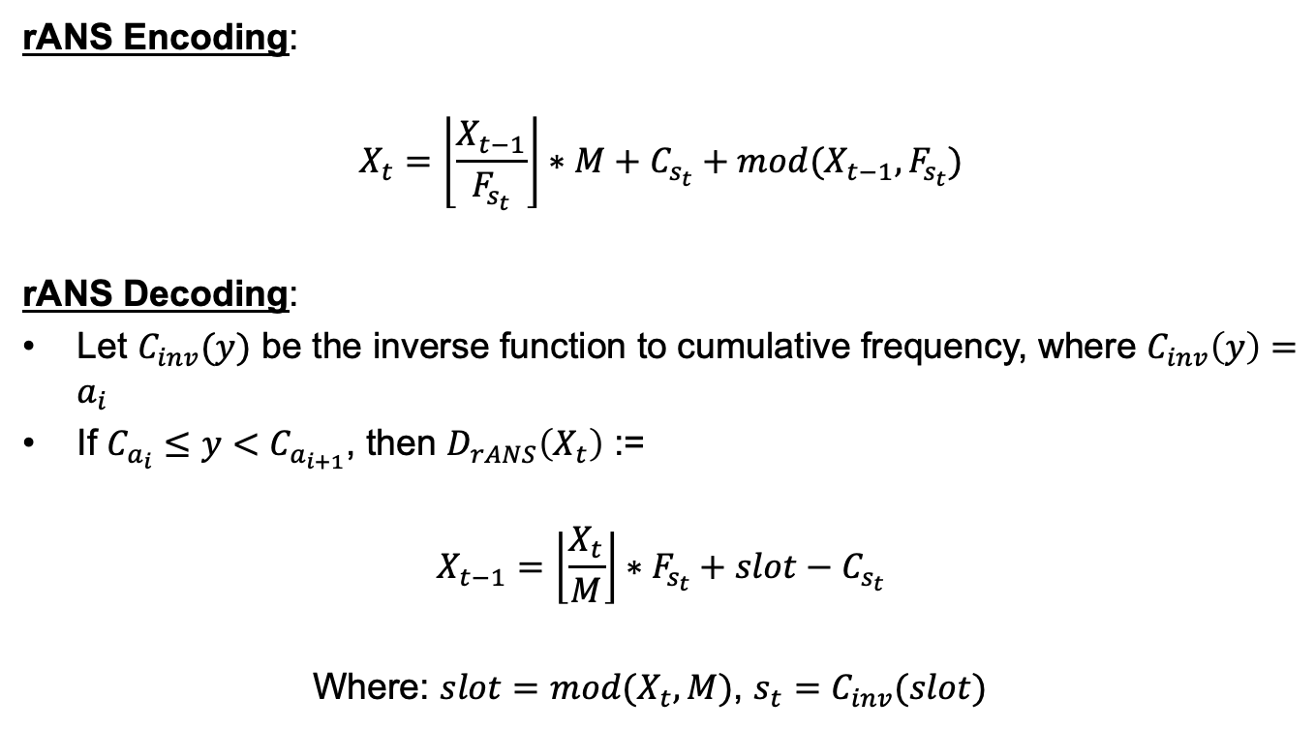
Range Asymmetric Numerical Systems (rANS) Encoding
rANS Encoding:
$$X_{t}=\left\lfloor \frac{X_{t−1}}{F_{s_{t}}}\right\rfloor ∗M+C_{s_{t}}+mod(X_{t−1},F_{s_{t}})$$
rANS Decoding:
Let $C_{inv}(y)$ be the inverse function to cumulative frequency, where $C_{inv}\left(y\right)=a_{i}$
If $C_{a_{i}}≤y<$ $C_{a_{i+1}}$, then $D_{rANS}\left(X_{t}\right)$ :=
$$X_{t−1}=\left\lfloor \frac{X_{t}}{M}\right\rfloor ∗F_{s_{t}}+slot−C_{s_{t}}$$
Where: $slot=mod(X_{t},M)$, $s_{t}=C_{inv}(slot)$

Slide 43
Fast rANS Encoding
Use adaptive models to adjust quantized probabilities on the fly based on previously observed symbols
Relax the PMF constraints - allow approximate PMF representations
No need pre-defined codebook (unlike in Huffman encoding)
Increases flexibility and efficiency in practical implementations, especially when exact PMF difficult or impractical to obtain
Good for parallelization, large datasets, and highly complex statistical structures

Slide 44
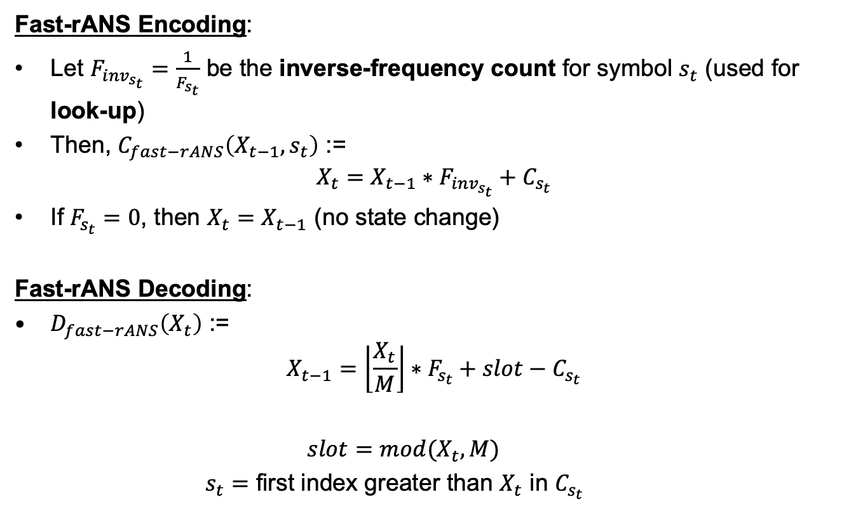
Fast rANS Encoding
Fast-rANS Encoding:
Let $F_{{inv}_{s_{t}}}=\frac{1}{F_{s_{t}}}$ be the inverse-frequency count for symbol $s_{t}$ (used for look-up)
Then, $C_{fast−rANS}\left(X_{t−1},s_{t}\right)$ :=
$$X_{t}=X_{t−1}∗F_{{inv}_{s_{t}}}+C_{s_{t}}$$
If $F_{s_{t}}=0$, then $X_{t}=X_{t−1}$ (no state change)
Fast-rANS Decoding:
$D_{fast−rANS}\left(X_{t}\right)$ :=
$$X_{t−1}=\left\lfloor \frac{X_{t}}{M}\right\rfloor ∗F_{s_{t}}+slot−C_{s_{t}}$$
$slot=mod(X_{t},M)$
$s_{t}=$ first index greater than $X_{t}$ in $C_{s_{t}}$

Slide 45
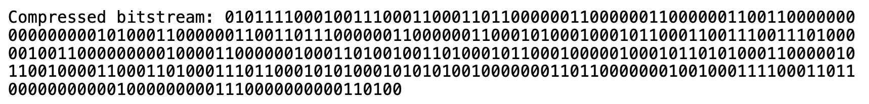
Encoded Bitstream
Bitstream: ‘01’ (lossless) + Encoded values (via fast-RANS)

Slide 46
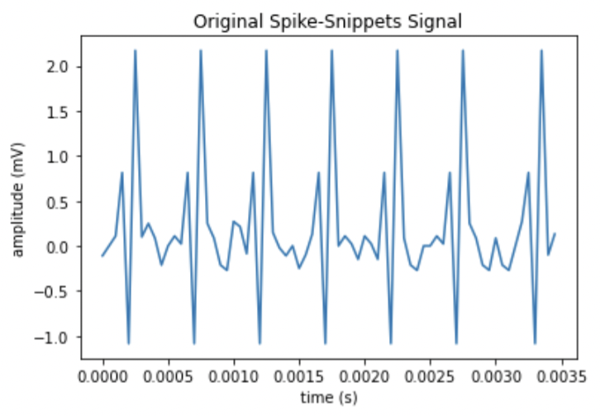
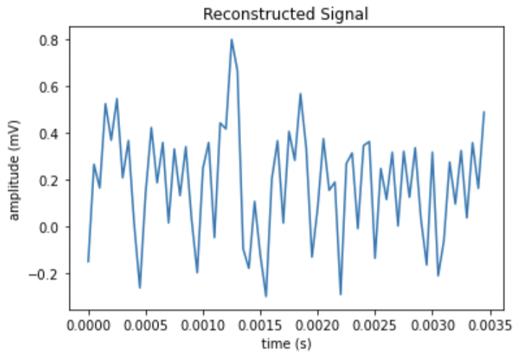
Signal Reconstruction
Original (left) signal vs Reconstructed (right) signal are expected to be different due to the “lossy” compression scheme. Notice that patterns (e.g., spikes) are still visible in the reconstructed signal.

Slide 47
Lossy (without characterization): Compression Ratio
Expected: 8:1 (dependent on specific implementation of fast rANS encoding)

Slide 48
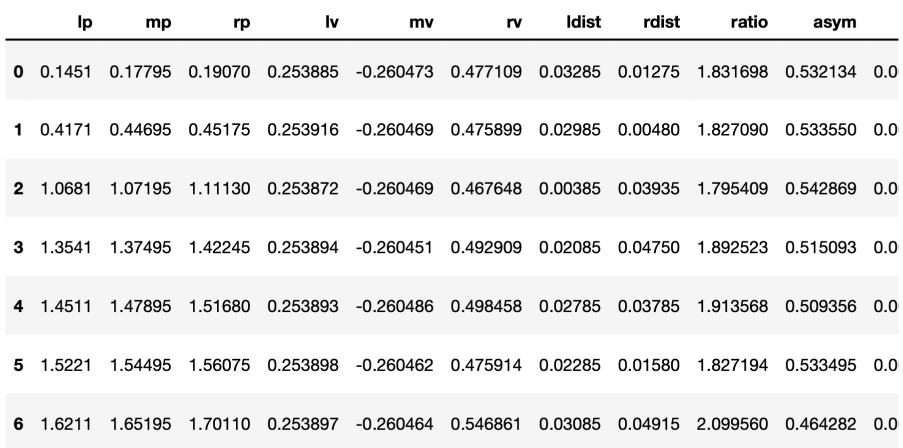
Now, Try Characterizing the Spikes
Choose a characteristic to classify the spikes (e.g., `ldist`, `rdist`, `rv`, etc.)
Estimate the PMF based on the characteristics (instead of approximation coefficients)
Keep everything else the same

Slide 49
Transmitted Bitstream

Slide 50
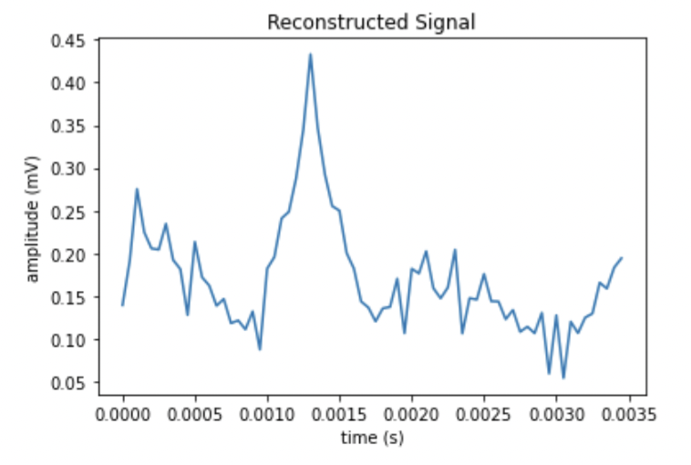
Signal Reconstruction
Original (left) signal vs Reconstructed (right) signal are expected to be different due to the “lossy” compression scheme. Now, with ‘rdist’ as our characteristic, we can see that the spike locations coincide with the local maxima and minima.

Slide 51
Lossy (with characterization): Compression Ratio
Expected: 23:1 (dependent on specific implementation of fast rANS encoding)

Slide 52
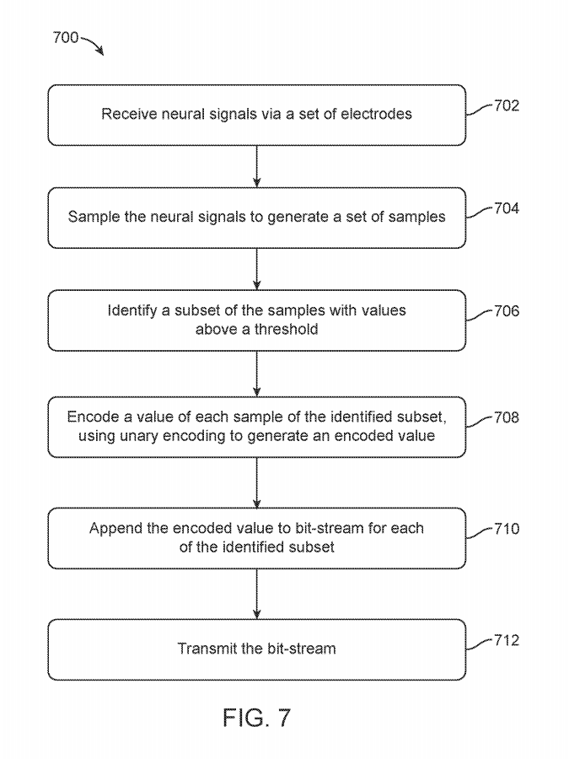
Sparse compression: Binned-Spikes
Spike events counted within windows of time
Subset of samples with values above threshold
Encode value for each subset sample via unary encoding
Append encoded value for each subset sample

Slide 53
Step 1:

Slide 54
Step 2:
Detect Neural Spikes
Use spike-snippets mode: Only take signals that revolve around spikes

Slide 55
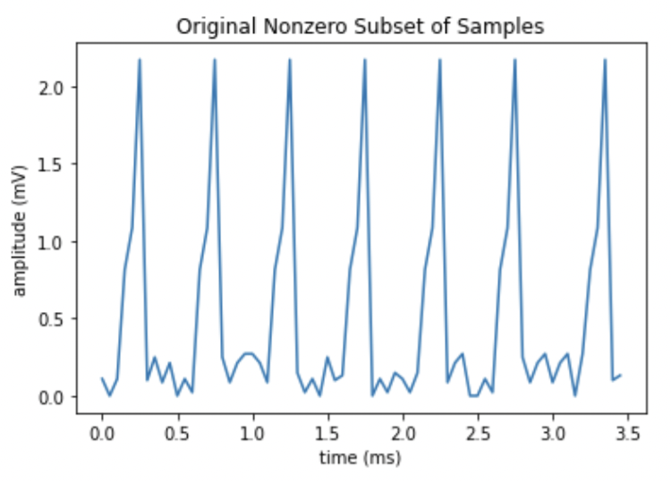
Step 3:
Only sample signals that are far from zero

Slide 56
Step 4:
Unary encoding - Use similar steps from “Lossless” compression (quotient Q to compute unary)
For x in decimal, need to first encode in Q8.8, find its quotient (Q), and then compute unary:
Q = (x * 2^8) / m
Unary = Q ‘1’s + ‘0’

Slide 57
Step 5:
All values are zero or close to zero - append “0” to bit stream
One or more values non-zero - append “1” to bit stream + encoded values

Slide 58

Step 6:
NOTE: Do NOT transmit bitstream if ALL samples are zero
Bitstream: ‘10’ (binned-spikes) + encoded values (unary)

Slide 59


Signal Reconstruction
Original (from step 3; left) vs decoded signals (right)

Slide 60
Binned-Spikes: Compression Ratio
Expected compression ratio: about 5:1

Slide 61

Sparse compression: Spike-Band Power Mode
Waveforms accumulated and averaged within time window
Estimated average power value
Subset of samples above threshold
Append estimated average power value to each subset sample

Slide 62
Step 1:

Slide 63
Step 1:
Detect Neural Spikes
Use spike-snippets mode: Only take signals that revolve around spikes

Slide 64

Step 2:
Filter the spike-snippets signal. Take its absolute value (for unary encoding)
Each sample corresponds to channel (values sampled in a per-channel basis)
n channels/samples

Slide 65

Step 3:
i.e, Measure average power (amplitude) in each sample
--> n-dimensional vector

Slide 66

Step 4:
e.g., Identify non-zero average power values (sparse - most values 0)

Slide 67

Step 5:
If sample average power zero --> append ‘0’ to bitstream
Else --> append ‘1’ + average power value to bitstream (encoded in unary)
Need to resample m (minimum # of bits) since we are computing average power
For x in decimal, need to first encode in Q8.8, find its quotient (Q), and then compute unary:
Resample m based on max power magnitude
Q = (x * 2^8) / m
Unary = Q ‘1’s + ‘0’

Slide 68

Step 6:
NOTE: Do NOT transmit bitstream if ALL samples are zero
Bitstream: ‘11’ (spike-band) + encoded values (unary)

Slide 69

Signal Reconstruction
Original (from step 4; left) vs decoded signals (right)
Notice unary encoding takes the quotient of each encoded value; since we are encoding a different measurement (average power), we effectively use smaller # of bits (m) to encode, resulting in a less diverse plot after decoding.

Slide 70
Spike-Band: Compression Ratio
Expected compression ratio: 30:1

Slide 71
Usage of Machine Learning to Detect Intent of Action
Can leverage machine learning models with compression techniques to determine intent of action by user (e.g., raise left hand, raise right hand, etc.) based on neural activity
For example, a high-bandwidth (high # of channels simultaneously transmitted) op-mode may be selected, such as sparse compression (binned-spikes or spike-band)
Compression data – configured to external device while mental activity performed
External device generates model to compute probabilities of each action executed by user
Model uploaded to neural transmitter
Neural transmitter directly translates neural activity to user actions
Compression ratio: order of 100:1

Slide 72
Conclusion
Introduced 4 compression techniques:
Lossless
Lossy
Sparse: Binned-spikes
Sparse: Spike-band
Each algorithm – yields different compression ratios
Compression algorithm of choice depends on dataset
Bitstreams – include prefix code denoting the compression technique

